Slide 1
GETTING READY FOR CUSTOMER INTERVIEW
2021

Slide 2
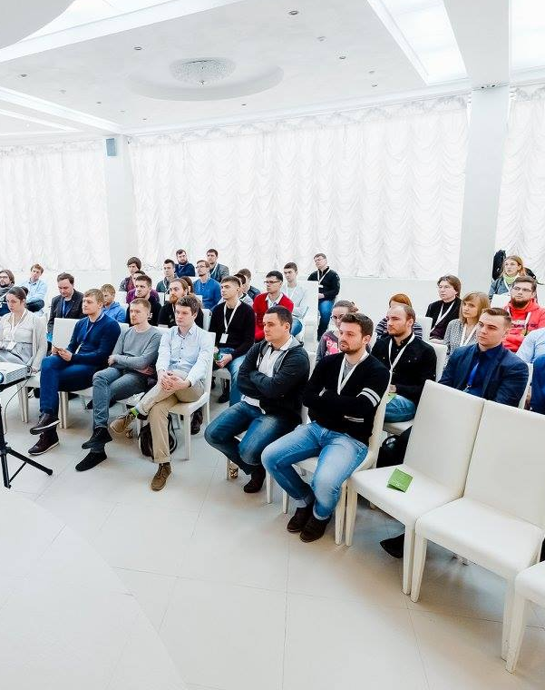
Agenda
1
Customer needs
2
Self-presentation pitch
3
EPAM vacancies
4
STAR TECHNIQIE
5
Examples and exercises
Notes:
Appendix includes recent awards, please visit elements.epam.com for all 2016-2017 awards

Slide 3
WHAT DOES CUSTOMER NEED?

Slide 4


Представьте, что Вы - Директор магазина и планируете проводить собеседование с кандидатом на вакансию продавца в ваш магазин. Что для вас будет важно в успешном кандидате
ⓘ Start presenting to display the poll results on this slide.

Slide 5
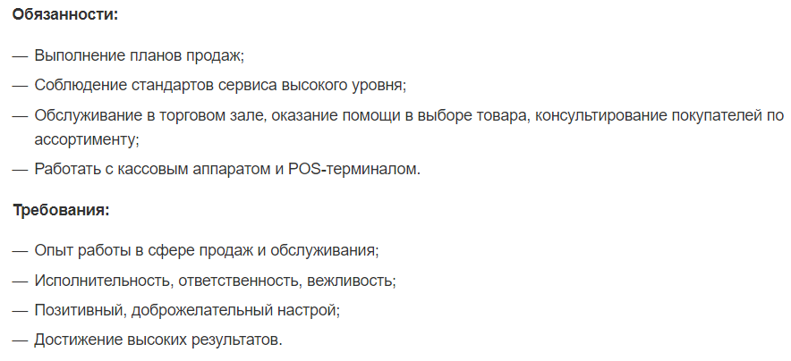
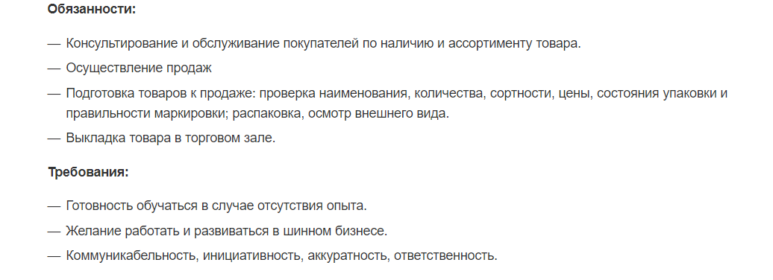
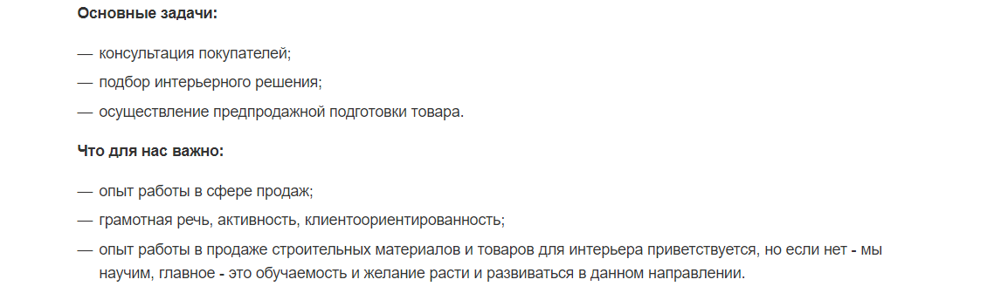
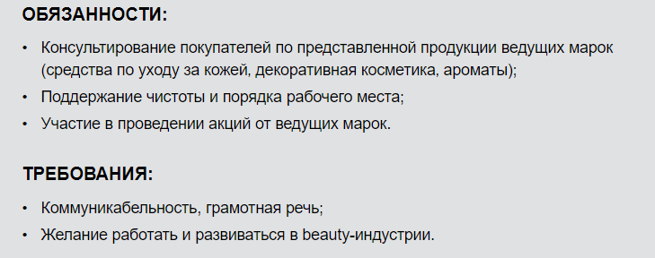
INTERVEW
1
3
2
4

Slide 6
GOALS
EMPLOYEE
CUSTOMER/manager
Demonstrate expertise that relevant for current position
Identify whether the person suitable for proposed role
Check skills:
- Hard skills (hand on experience and professional knowledge)
- Soft skills

Slide 7

INTERVEW OVERVIEW
Time
Interview: 15-60 minutes
Self-presentation: 5-7 minutes
Who is the interviewer
Manager (Customer/PM/DM/RM) + technical specialist

Slide 8
VACANCIES
Customer
Liberty Global Services
LIBG-OBO
Key Developer
Position Description
We’re looking for Automation Developer (Devops Engineer) to execute and support video services platform transition from on-premises infrastructure into AWS cloud environment. This individual will work with a number of services, backend applications and infrastructure elements to automate their provisioning, enable swift deployment and smooth operations.
Required skillset:
• Proficiency with Linux;
• Experience working with cloud services providers;
• Deep knowledge/ production experience with AWS ;
• Experience in building end-2-end continuous delivery solutions (IaC, CI/CD, CCM)
• Advanced level in Ansible and/or Terraform
• Scripting skills (Python, shell);
• Strong understanding SDLC and typical software development practices / methodologies
• Monitoring/troubleshooting tools/skills;
Our technology stack:
• Linux/Java/ Python;
• AWS (Ec2, VPC, TVPC, TGW, RDS, R53, NLB/ALB, etc…)
• Terraform, Ansible, Vault, Jenkins, Packer
• Automated testing (infrastructure testing, configuration testing, component testing, E2E testing, etc… up to 15 quality gates);
• Custom software appliances (video streaming) on top of AWS;
• Prometheus, Icinga, Grafana;
• CI / CD & DevOps Culture;
Project Description
Disaster Recovery design and implementation.
Google it
Ask RM – information about domain and customer needs

Slide 9
SELF-PRESENTATION PITCH. 10 YEARS IN 10 SENTENCES.
YOUR REAL hands-on experience
Task / challenge. Job description
Interviewer’s background
“TELL ME ABOUT YOURSELF…”
Notes:
Specific Video Links:
Corporate Presentations:
- DPES position – bit dated but this material landed us in lead category for Forrester wave - https://videoportal.epam.com/video/LoEpvyad
- Global Locations – Elaina Shekhter & Eli Feldman - https://videoportal.epam.com/video/noZmMgaq
- Data Intelligence Practice – Max Bogretsov - https://videoportal.epam.com/video/7oWwGGoP
- Digital Services – Kevin Labick - https://videoportal.epam.com/video/2RdLp8Rd
Industry Presentations
- Energy Practice – Alan Harlan, John Chu - https://videoportal.epam.com/video/qay0ByJl
- Healthcare – Alan Harlan, Daniel Estrada, Jacob Jesson, Yuriy Gankin - https://videoportal.epam.com/video/9o36K2al
- Digital in Retail – Kevin Labick, Valeri Makovic, Dan Kjaergaard, Pedro Silva, & Robin Smith - https://videoportal.epam.com/video/BR0XWbRl
Focus Areas/Products
- IoT – Eli Feldman - https://videoportal.epam.com/video/nR49ZzJD & https://videoportal.epam.com/video/nR4X2ARD + https://videoportal.epam.com/video/BR0X1bRl
- API Strategy – Max & Pavel Veller - https://videoportal.epam.com/video/xazMdLJG
- Cloud Services – Eli Feldman - https://videoportal.epam.com/video/7oWlpvRP
- Blockchain – FB1, Ilya Romanov, Roman Polupanov - https://videoportal.epam.com/video/Koe9n7oq
- DevOps – Eli & Dmitry Tikhomirov - https://videoportal.epam.com/video/LoBm2ba9
- InfoNgen – Serge Velychko - https://videoportal.epam.com/video/PaK27VJ0

Slide 10
SELF-PRESENTATION PITCH. 10 YEARS IN 10 SENTENCES.
Prepare before each interview
Self-presentation based on recent and relevant experience and knowledge
We get acquainted with the description of the position, the project, the tasks for the position in advance
Preparing our questions for the manager
Feedbacks’ analysis
We are learning to make self-presentation flexible and targeted for each individual vacancy
Notes:
Specific Video Links:
Corporate Presentations:
- DPES position – bit dated but this material landed us in lead category for Forrester wave - https://videoportal.epam.com/video/LoEpvyad
- Global Locations – Elaina Shekhter & Eli Feldman - https://videoportal.epam.com/video/noZmMgaq
- Data Intelligence Practice – Max Bogretsov - https://videoportal.epam.com/video/7oWwGGoP
- Digital Services – Kevin Labick - https://videoportal.epam.com/video/2RdLp8Rd
Industry Presentations
- Energy Practice – Alan Harlan, John Chu - https://videoportal.epam.com/video/qay0ByJl
- Healthcare – Alan Harlan, Daniel Estrada, Jacob Jesson, Yuriy Gankin - https://videoportal.epam.com/video/9o36K2al
- Digital in Retail – Kevin Labick, Valeri Makovic, Dan Kjaergaard, Pedro Silva, & Robin Smith - https://videoportal.epam.com/video/BR0XWbRl
Focus Areas/Products
- IoT – Eli Feldman - https://videoportal.epam.com/video/nR49ZzJD & https://videoportal.epam.com/video/nR4X2ARD + https://videoportal.epam.com/video/BR0X1bRl
- API Strategy – Max & Pavel Veller - https://videoportal.epam.com/video/xazMdLJG
- Cloud Services – Eli Feldman - https://videoportal.epam.com/video/7oWlpvRP
- Blockchain – FB1, Ilya Romanov, Roman Polupanov - https://videoportal.epam.com/video/Koe9n7oq
- DevOps – Eli & Dmitry Tikhomirov - https://videoportal.epam.com/video/LoBm2ba9
- InfoNgen – Serge Velychko - https://videoportal.epam.com/video/PaK27VJ0

Slide 11
INTERVIEWER'S BACKGROUND
TALKING TO TECHNICAL SPECIALIST / SOLUTION ARCHITECT / KEY DEVELOPER​ | TALKING TO ADMINISTRATIVE SPECIALIST / POWER BUSINESS USER / PRODUCT OWNER​
…Frameworks, libraries, gadgets, reusable components​ | …competitive technology / stable solution / wide technical community if support is required…​
…Single Page Application​ | …fast site / portal navigation, prompt link access​
… unit testing​ | …product quality, sustainability​
…CI/CD pipeline ​ | …uninterrupted delivery, better time-to-market​
…Public APIs, sophisticated, technically complex integration solutions​ | …flawless / compatible usage with the most popular social networks​
…video content rendering​ | …possibility to watch your favorite movie using your mobile device​
…SLA​ | …transparency of process / service​
Notes:
Specific Video Links:
Corporate Presentations:
- DPES position – bit dated but this material landed us in lead category for Forrester wave - https://videoportal.epam.com/video/LoEpvyad
- Global Locations – Elaina Shekhter & Eli Feldman - https://videoportal.epam.com/video/noZmMgaq
- Data Intelligence Practice – Max Bogretsov - https://videoportal.epam.com/video/7oWwGGoP
- Digital Services – Kevin Labick - https://videoportal.epam.com/video/2RdLp8Rd
Industry Presentations
- Energy Practice – Alan Harlan, John Chu - https://videoportal.epam.com/video/qay0ByJl
- Healthcare – Alan Harlan, Daniel Estrada, Jacob Jesson, Yuriy Gankin - https://videoportal.epam.com/video/9o36K2al
- Digital in Retail – Kevin Labick, Valeri Makovic, Dan Kjaergaard, Pedro Silva, & Robin Smith - https://videoportal.epam.com/video/BR0XWbRl
Focus Areas/Products
- IoT – Eli Feldman - https://videoportal.epam.com/video/nR49ZzJD & https://videoportal.epam.com/video/nR4X2ARD + https://videoportal.epam.com/video/BR0X1bRl
- API Strategy – Max & Pavel Veller - https://videoportal.epam.com/video/xazMdLJG
- Cloud Services – Eli Feldman - https://videoportal.epam.com/video/7oWlpvRP
- Blockchain – FB1, Ilya Romanov, Roman Polupanov - https://videoportal.epam.com/video/Koe9n7oq
- DevOps – Eli & Dmitry Tikhomirov - https://videoportal.epam.com/video/LoBm2ba9
- InfoNgen – Serge Velychko - https://videoportal.epam.com/video/PaK27VJ0

Slide 12
SELF-PRESENTATION PITCH.
What am I? – Core skills, experience, roles.
My current project is about… (business goal)
The main challenge is / was … (few technical details)
My role / my contribution … (the difference made)
I was responsible for … (Primary tasks and responsibilities… Tools and technologies used…)
Project methodology (processes / communications) …
Career plans and goals – motivation (address for position)
Notes:
Specific Video Links:
Corporate Presentations:
- DPES position – bit dated but this material landed us in lead category for Forrester wave - https://videoportal.epam.com/video/LoEpvyad
- Global Locations – Elaina Shekhter & Eli Feldman - https://videoportal.epam.com/video/noZmMgaq
- Data Intelligence Practice – Max Bogretsov - https://videoportal.epam.com/video/7oWwGGoP
- Digital Services – Kevin Labick - https://videoportal.epam.com/video/2RdLp8Rd
Industry Presentations
- Energy Practice – Alan Harlan, John Chu - https://videoportal.epam.com/video/qay0ByJl
- Healthcare – Alan Harlan, Daniel Estrada, Jacob Jesson, Yuriy Gankin - https://videoportal.epam.com/video/9o36K2al
- Digital in Retail – Kevin Labick, Valeri Makovic, Dan Kjaergaard, Pedro Silva, & Robin Smith - https://videoportal.epam.com/video/BR0XWbRl
Focus Areas/Products
- IoT – Eli Feldman - https://videoportal.epam.com/video/nR49ZzJD & https://videoportal.epam.com/video/nR4X2ARD + https://videoportal.epam.com/video/BR0X1bRl
- API Strategy – Max & Pavel Veller - https://videoportal.epam.com/video/xazMdLJG
- Cloud Services – Eli Feldman - https://videoportal.epam.com/video/7oWlpvRP
- Blockchain – FB1, Ilya Romanov, Roman Polupanov - https://videoportal.epam.com/video/Koe9n7oq
- DevOps – Eli & Dmitry Tikhomirov - https://videoportal.epam.com/video/LoBm2ba9
- InfoNgen – Serge Velychko - https://videoportal.epam.com/video/PaK27VJ0

Slide 13
Questions
Tell me about a situation when...
Give an example where you...
What do you consider as the biggest accomplishment (or the biggest mistake) in your present (or past) job?
Notes:
Интервьюеры могут задавать такие вопросы, как «расскажите мне о ситуации, когда…»; или «приведите пример, где вы ..?»; или «какое ваше самое большое достижение?».
Отвечая на них, важно не давать общие ответы. Ваши ответы должны быть конкретными и иметь достаточно деталей для интервьюера, чтобы он мог оценить и обнаружить те навыки и компетенции, которые ищет заказчик.

Slide 14
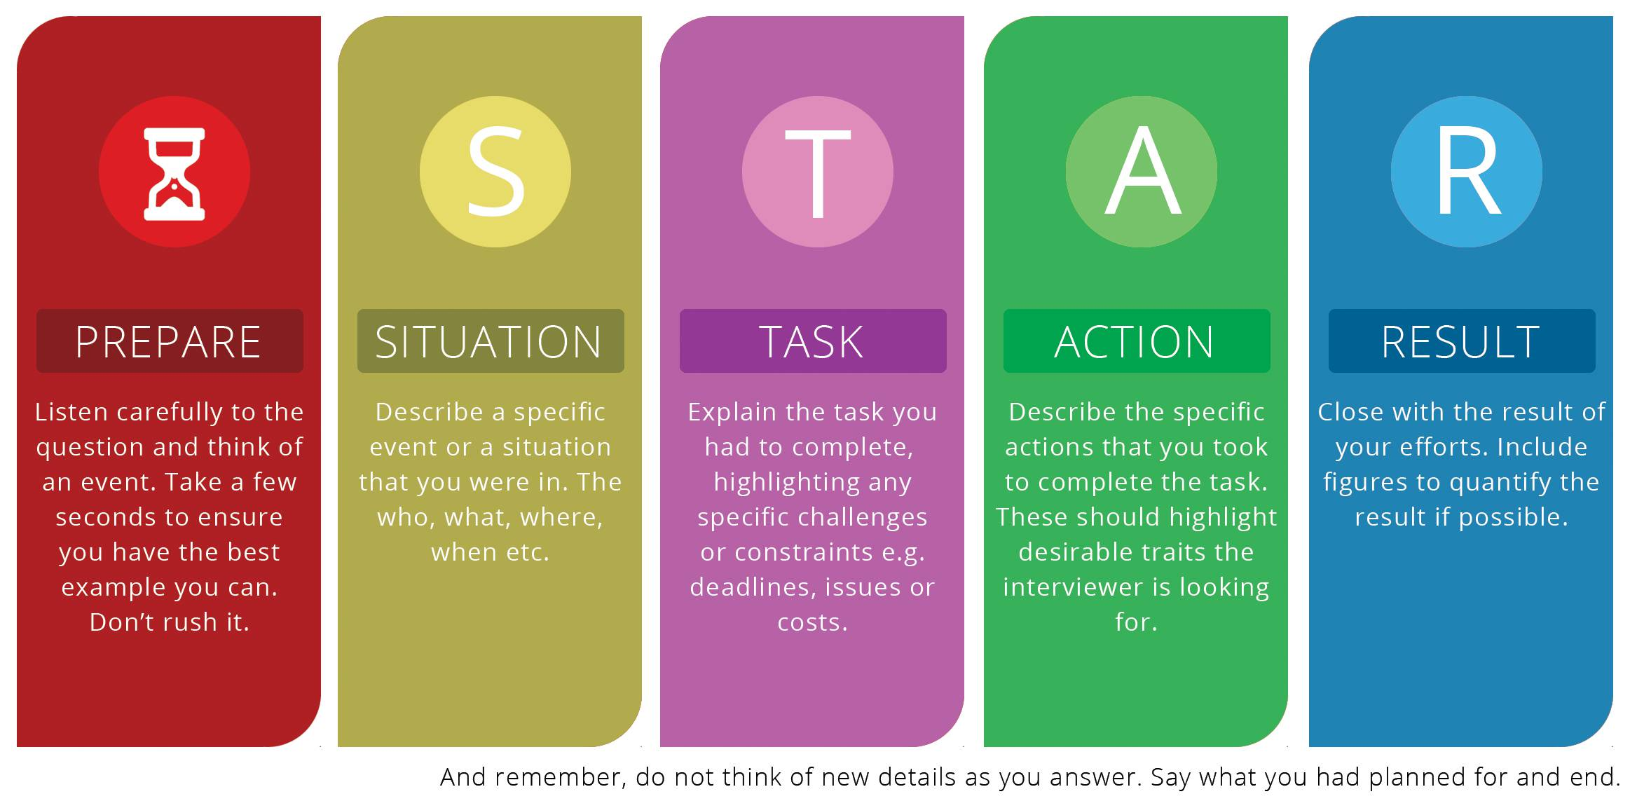
STAR TECHNIQIE
Notes:
Техника STAR может помочь справиться с такими вопросами, чтобы вы могли структурированно рассказать о своем опыте, навыках и компетенциях.
Ситуация: коротко опишите проект и/или ситуацию. На втором шаге объясните задачу, которую вы должны были выполнить, выделив конкретные проблемы (например, сроки, затраты и другие вопросы). К какой цели вы стремились? Первые два шага, ситуация и задание, составляют начало вашей истории. Они должны занимать не более 25% вашего ответа. Это значит – около 30 секунд.
На третьем этапе опишите конкретные действия, которые вы предприняли для выполнения задачи. Это основа вашей истории, где вы демонстрируете свои навыки и знания интервьюеру, чтобы показать, что вы подходите для этой работы. При описании своих действий обязательно укажите ответы на вопросы: что вы делали? Зачем вы это сделали? Как вы сделал это? Кто был вовлечен? Не забудьте, что в первую очередь вы говорите о себе. Какие конкретные этапы вы прошли и каков был ваш личный вклад в общее дело? Если речь идет о проекте, не рассказывайте о действиях других участников. Используйте местоимение "я", а не "мы".
На четвертом этапе поговорите о результатах ваших действий. Это завершение вашей истории, что случилось, что было достигнуто. Что произошло? Каков был результат? Чего вы добились? Чему вы научились? Включите цифры, если это возможно.
Ваш ответ должен быть от 2 до 3 минут.
Отвечая на эти вопросы, помните, что интервьюер ищет конкретные примеры, которые демонстрируют компетенции, имеющие отношение к должности.

Slide 15
STAR TECHNIQIE: EXAMPLE
I was working in a team of six engineers and we were developing a new finance module for our core accounting product. At first we thought we would complete the project on time but then two team members, including our team leader, fell seriously ill. | Situation
And suddenly the team was under serious pressure to meet the deadline. We had to meet the original deadline though we were short-staffed and without our team leader. | Task
Well, I was up-to-speed with all the project activities and I was pretty confident in my programming skills, so I volunteered as a team leader. My technical analysis skills helped me to spot a few small mistakes in the initial coding, which were causing the sporadic errors, and slowing us down. I then negotiated with our product owner a small bonus incentive for the team, and the budget for two pizza evenings. So we could pull a couple of late night shifts to correct the coding and catch up with the critical project milestones. | Action
As a result we overspent the budget by only 1.5% and delivered the software on time. I’m pretty sure the project was a great success as the additional project cost was minimal compared to the costs of delaying the launch. The team were delighted with the extra bonus and I’ve been promoted to team leader. | Result
Notes:
Какие слова/выражения использованы в этом ответе в каждой части ответа?

Slide 16
STAR TECHNIQIE: LANGUAGE
SITUATION: Where? When?
I was working in a team of…
Way back in 2008…
At the beginning of last year…
Early in my career I worked on the project…
On my previous project…
When I was involved in…
TASK: What had to be done? Why?
We had to…
I was challenged to…
I was required to…
I was asked to…
My team/I was expected to…
My role was to…
It was my responsibility to…
Our customer wanted us to…

Slide 17
STAR TECHNIQIE: LANGUAGE
ACTION: What did you do? How did you do it?
I volunteered as a team leader…
I spotted a few small mistakes…
I then negotiated with our product owner…
RESULT: What happened?
We delivered the software on time…
I’ve been promoted to…
I grew a lot working on …
It taught me…
Through this experience I …
As a result, the implemented feature improved functionality by 100%
My suggestion facilitated data handling, so now it’s 3 times faster than before

Slide 18
STAR TECHNIQIE:PRACTICE
№ | THE STAR ELEMENTS | Your answers
1 | So, we managed to meet the deadline, because of my commitment, and we got the money that we needed.
2 | On my previous project XYZ, we were preparing to roll out the new release of our online corporate banking platform.
3 | After a lot of back and forth with the engineers and the senior people in Product and Marketing, I drafted the announcement to the customers. I emphasized the positive aspects of the new functionality, explained the delay, and established the timeline for the full functionality.
4 | Our efforts brought in 10 percent more Web traffic, resulting in more customers.
5 | My role was to manage the communications to customers about the new release, which involved coordinating with dozens of people from Technology, Operations, various Product areas, Customer Service, and Marketing.
6 | The developers were running into technical problems with the new reporting feature that was supposed to be the centerpiece of the release. In order to make the release date, they had to offer only limited functionality. We knew that some clients would be disappointed.
7 | My responsibility was to make sure that we met the deadline that had been set by investors, so we got the money that we needed.
Notes:
Практика: сначала каждый работает индивидуально, потом обсуждаем ответы в группе
Все переходят по ссылке https://epam-my.sharepoint.com/:x:/p/angelina_furman/EfTaC70a_GtJmFDFB5BTBb0BgoyV7XlH2yVOqikf_sYmsg?e=c2DLG7
И во вкладке со своим именем самостоятельно пишут ответы
Далее обсуждаем в группе правильные ответы

Slide 19
Thank you for attention!

Slide 20
Prepare self-presentation
Oleg Sakhabutdinov | Nikolai Dvoinishnikov
Ilia Ershov1 | Sergei Kutovoi
Maxim Cherepennikov | Aleksandr Popov2
Nikolai Goritskii | Evgenii Kolganov
Timofey Kurakin | Dmitrii Ivanov7
Vladimir Emelianov
25/10 18:30
Iuliia Kuleshova | Vladimir Intulov
Evgeny Malyshev1 | Aleksei Dmitruk
Mikhail Kalmykov | Rinat Sadykov
Pavel Iskandarov | Vladimir Gushchin
Maxim Tyakin | Yevgenii Kungurov
Aleksandr Ivanov13 | Vladislav Iakovlev
27/10 18:30

Slide 21
Роли
Кандидат – рассказывает свою самопрезентацию
Интервьер – задает вопросы согласно заданным вводным, даёт комментарии
Наблюдатели – задают вопросы и дают комментарии
Тайминг
15 минут – время прохождения одного интервью
5 мин – самопрезентация
5 мин – вопросы
5 мин - комментарии

